Slide 1

ORIENTAL COLLEGE OF TECHNOLOGY
DEPARTMENT OF COMPUTER SCIENCE AND TECHNOLOGY
BLOG APPLICATION
PROJECT SUPERVISED BY:
PROJECT GUIDED BY: PROJECT TEAM:
UJJAWAL KUMAR TIWARY 0126CS19117
SUMUKH PATIDATR 0126CS19111
SUDDEP KUMAR BATKYA 0126CS191112
PUSHPRAJ SINGH PAWAR 0126CS191085
academic year 2021-22 Academic session > January to July

Slide 2
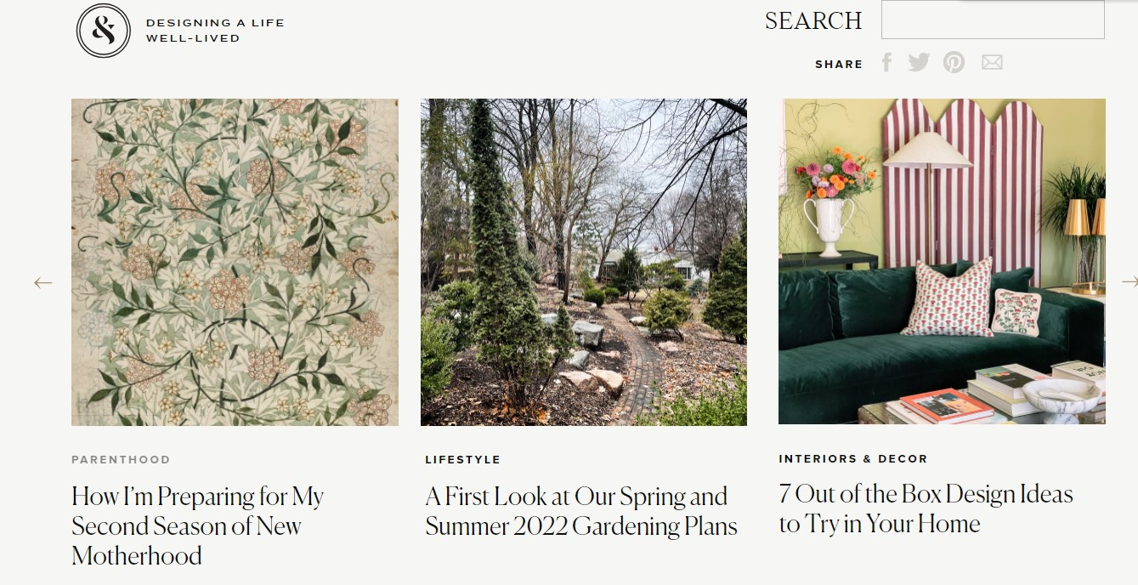
What is a blog?
A Blog is a regularly updated
Website where people write about topics for their readers and keep posting about the things . Topics may vary from personal experience , educational blogs ,technical reviews , lifestyle blogs, cooking blogs or even a simple tour review.

Slide 3
Objective of THIS PROJECT :
Providing user(authors) with an interface where they can write blogs ,edit it, engage with readers, take feedback and make an impact with their work and blog.

Slide 4

Website vs blog
WEBSITE
BLOG
According to need.
Specific to business demand.
Static websites have barely update.
User Engagement
Content
Content updating frequency
Driving factor
Provided by likes, share ,comment section , subscription to new posts Etc.
Could be anything informative , educational ,product review, views on life Etc.
Regular posts are made on hourly or daily basis.

Slide 5




Technology platform : overview

Slide 6
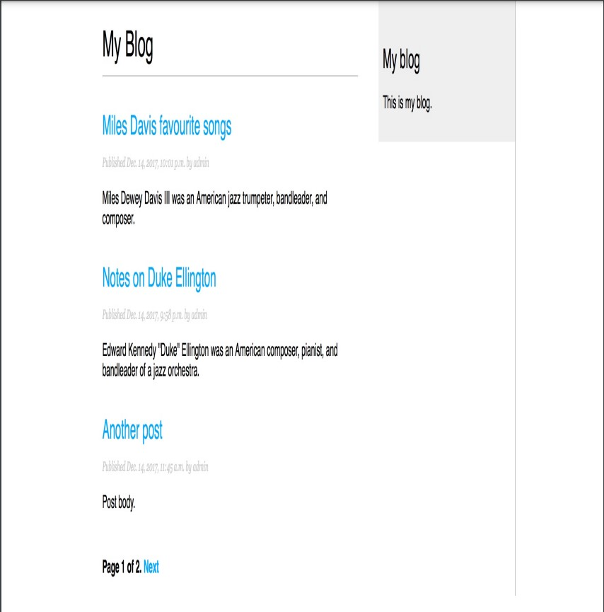
Application feature : overview
Displaying blog post on the website.

Slide 7
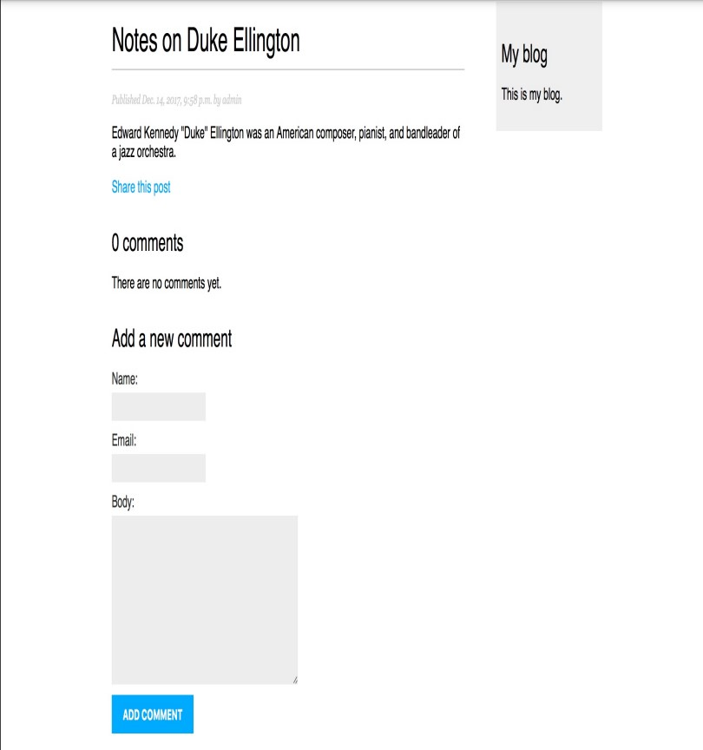
User engagement through
comment section .

Slide 8
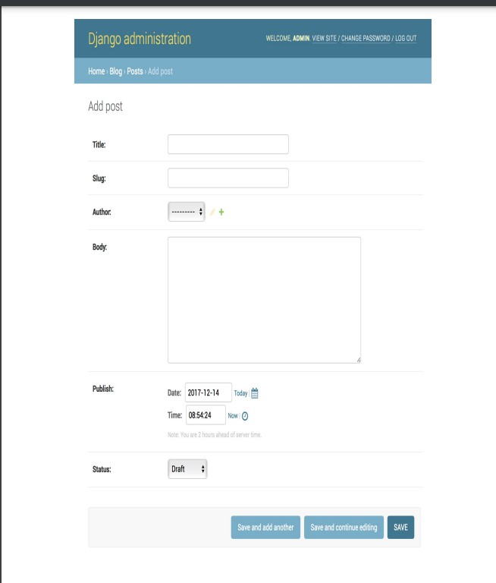
Interface to add new post edit old post to the authors and admin of the site.

Slide 9
Project evaluation:
Our team can feasibly carry out this project . Our project is in the developmental stage at the moment . All involved in the project are aware of the objectives and goals of the project.
We have installed perquisites for this project and listed out activities needed to be
done to carry out the project.

Slide 10
Future work:
Connecting to database.
Connecting google authentication A.P.I.
Deploying to Heroku or any other hosting platform.

Slide 11
Learning from the project:
Web development insights.
User response and designing websites.
Retrieval of data from the user and displaying it on website.
Adding bootstrap to enhance responsiveness and speed .

Slide 12
Conclusion
Blogs can easily create awareness among the masses of all age and groups on plethora of social
Topics , these blogs are also great for educational purposes not only in academic form but also
Other facets of life such as lifestyle , mental wellbeing etc.
Our team is prepared for building this blog application.

